Slide 1
1) Overview
This package is the basic package of COE core, like its name. It provided many basic and common abilities which can be used by other modules of COE.

Slide 2
2) clUtility module
The clUtility module is the basic module of COE, like its name, it offers many basic utilities, e.g. math calculation, string process, zip/unzip, multi-language, file process, xml, encrypt/decrypt, etc…

Slide 3
Class name | Description
ColorSelector | This class can pick a color easily.
CryptoUtil | The helper class which can encrypt/decrypt file.
DataHelper | This class can do some conversions of basic data.
DateHelper | This class can do something about date.
ExpressionCalc | This class can evaluate the expression, and calculate the value.
FileHelper | Use this class to implement some useful functionalities for file.
IntegerList | This class wrappers some functions for integer list.
LibXlHelper | A helper class for excel parser.

Slide 4
Class name | Description
MultiLanguageMgr | The management class for multi-language translation.
PathHelper | This class deals with issues about file path.
ProcessMgr | Use this class to manage the process.
RandomGen | This class can generate the random values.
StringUtil | This class will perform some conversions about the string.

Slide 5
3) clDbWrapper module
The clDbWrapper module is the basic module of COE, it offers abilities of database visiting.
Class name | Description
DBConnect | The interface for the database connection.
DBField | A DBField object is a field data within a record.
DBFieldList | DBField list.
DBRecord | This class stand for one row data of a table.
SQLiteConnect | The connection to SQLite database.

Slide 6
4) clDrawWrapper module
The clDrawWrapper module is the basic module of COE, it offers rendering abilities.
Class name | Description
GDIDrawer | GDI drawer.
GlViewPort | OpenGL view port.
GplusViewPort | GDI+ view port.

Slide 7
5) clGeometryBase module
The clGeometryBase module is the basic geometry module of COE, it defined basic geometry types such as point, line, arc, triangle, rectangle, polygon, loop, and some other basic data such as vector, matrix.

Slide 8
Class name | Description
Arc2D | 2D arc.
BasicGeometryDrawer | The drawer which can render basic geometries.
CursorDrawer | The drawer which can render mouse cursor.
ILineArc2D | The interface for 2D line and arc.
Line2D | 2D line.
LineArc2DList | The list of 2D line and arc.
LineArc2DLoop | The loop which composed of 2D line and arc.
LineArc2DLoopManager | The management class for 2D line and arc loop.
LineArc2DProcessor | This class can process 2D line and arc.
LineArc2DStaticControl | The static control for displaying 2d line and arc.

Slide 9
Class name | Description
Matrix2D | Matrix class.
Path2D | The 2D path.
Point2D | 2D point.
Point2DList | 2D point list.
Polygon2D | The 2D polygon class.
Polygon2DBuilder | This class is the builder for 2D polygon.
Polygon2DList | The 2D polygon list.
Polygon2DProcessor | This class can process 2D polygon.
Rect2D | 2D rectangle class.
Triangle2D | 2D triangle class.
Vector2D | 2D vector class.

Slide 10
6) clBaseData module
The clBaseData module is the basic data module of COE, it defined basic data types of COE core.

Slide 11
6.1) Basic class of COE data
Class name | Description
IData | The interface of COE data.
ClData | Default implementation of interface IData.
IBusinessData | The interface of COE business data, e.g. part, sheet, expert library, etc.
BusinessData | Default implementation of interface IBusinessData.

Slide 12
6.2) Basic class of COE observer mechanism
COE uses observer mechanism to subscribe and publish events.
Class name | Description
IObserver | The interface for all observer classes.
ObserverBase | Default implementation of interface IObserver.
ObserverList | The observer list.
ISubject | The subject interface which can be observed by observers.
SubjectBase | Default implementation of interface ISubject.

Slide 13
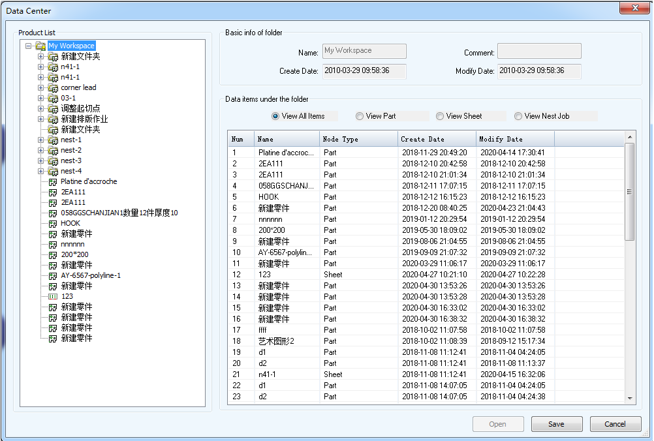
6.3) COE data center
COE Data center displayed business data in COE database by tree and table UI controls. In this section, we will introduce data structures which can support the data center, these data structures defined the hierarchical structure of the data center.

Slide 14
Class name | Description
IProductItem | Product item interface, the interface of all info in data center.
ProductItemBase | Default implementation of interface IProductItem.
ProductItemList | The product item list.
DataItem | Data item is the data object in data center, e.g. part, sheet, nest job.
FolderNode | Folder item is the folder in data center.
ProductItemLoader ProductItemWriter | Used to save/load data center to the COE database.
ProductStructProcessor | The processor for the data center.

Slide 15
6.4) COE data property
All data of COE have ability to define their properties, they can expose their data by the property, e.g. the array pattern can expose its row/column number for viewing/modifying by its property data.
Class name | Description
DataProperty | The property of COE data.
DataPropItem | Property item of the property, e.g. arc radius is a property item of the property of the arc pattern.

Slide 16
6.5) COE log file
COE provided ability to write the log file, programmers can write the important information to the log file, COE’s log file is in “journal” folder.
Class name | Description
LogMessage | The log message.
LogMessageList | The log message list.
LogMgr | The log message manager.

Slide 17
6.6) Other COE basic data
Class name | Description
HelpVideo HelpVideoCategory | Help video object of COE.
VideoInfoLoader | Use this class to load the help videos of COE.
ProductFileManager ProductFolderManager | These classes can be used to query all files and folders within COE directory.
LicenseManager | This class can manage the license of COE core.
TaskEx ProgressData | TaskEx class can work as the base class of all COE task objects, ProgressData class is the progress info of task object.
ImgData | This class wrappers an image object.

Slide 18
7) clUILib module
The clUILib module is the basic user interaction module of COE, it defined basic abilities of GUI and interactive action.

Slide 19
7.1) Basic GUI data structures
This section will introduce the basic and reusable GUI data structure of COE core, these GUI objects based on MFC GUI objects and provided more powerful abilities, e.g. table control, list box control, edit control, combo box control, tree control, resizable dialog, etc.

Slide 20
Data structures for grid list control
Class name | Description
CGridListCtrlEx | The class of grid list control.
CGridColumnTraitText | The static text column of the grid list control.
CGridColumnTraitEdit | The editable text column of the grid list control.
CGridColumnTraitCombo | The combo box column of the grid list control.
Extension data structures for MFC property grid control
Class name | Description
NumberProp | The number type property value for MFC property grid control.
CheckBoxProp | The check box type property value for MFC property grid control.

Slide 21
Other data structures
Class name | Description
ColorComboBox | The combo box which can display its contents as different color bars.
MulColComboBox | The combo box has such abilities, multiple rows and the colorful text.
CNumEdit | The edit box which support integer/float value input.
XRibbonBtn | The ribbon button which can display the balloon-style tips.
BalloonHelp | The balloon style window.
XMenu | Menu class which can create a menu easily.
BMPStatic ImgStatic | The static controls which can display images.
ColorStatic | The static controls which can be filled with different colors.

Slide 22
Other data structures
Class name | Description
CPictureEx | The static control which can display animated pictures.
XTreeCtrl | The powerful tree control which can be easily used.
XBarBase | The base class of floating, dockable panel of COE.
CLDialog | The base class of COE dialog which provided ability of multi-language translation.
CLResizableDialog | The base class of COE resizable dialog.

Slide 23
7.2) Basic data structures of interactive action
About this section, we have introduced it clearly in other two documents, please refer to section 4 in document “4 - Software Architecture of COE”, and also need to refer to document “7 - COE Interactive Action Programming”.

Slide 24
7.3) Basic data structures of command
About this section, we have introduced it clearly in other documents, please refer to section 4 of document “7 - COE Interactive Action Programming”.
Class name | Description
ICommand CommandBase | The interface and the default implementation of all COE commands.
CommandList | The command list.
CommandManager | The management class for command which can undo/redo commands and do other operations.

